Slide 1
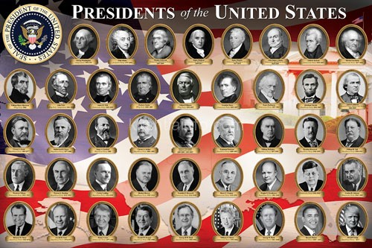
Presidential Speeches
1789 2020
By Nicole Semerano

Slide 2



Sources
1018 speeches
23.8 million words
NLTK

Slide 3
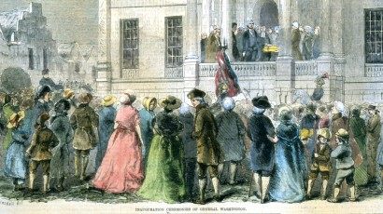
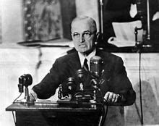
Data
Shortest
Washington's 2nd Inaugural Address -- 787
Longest
Truman's State of the Union (1946) -- 169750

Slide 4
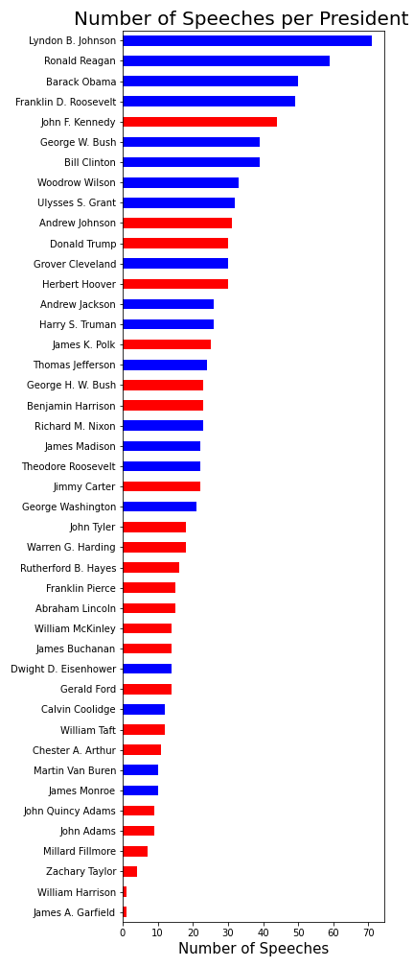
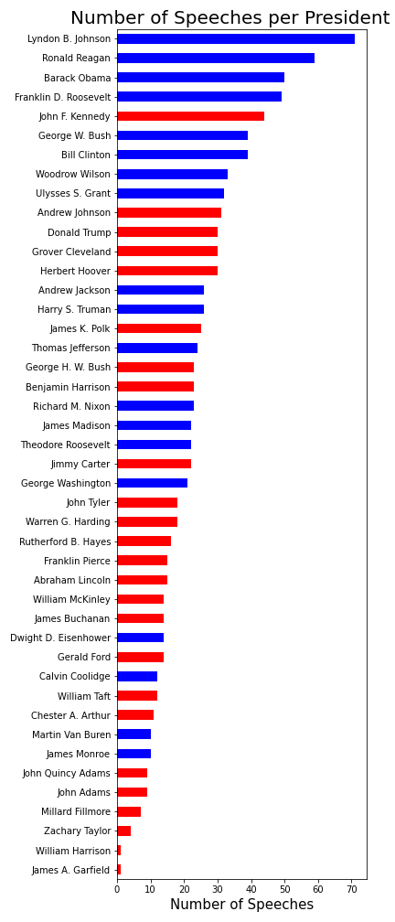
Lyndon B. Johnson 71
Ronald Reagan 59
Barack Obama 50
-------------
William Harrison 1
James A. Garfield 1

Slide 5
Top Topics
Domestic
department, commission, officers, commerce, court, conditions, attention, report, navy
Economy Part 1
tax, jobs, governor, percent, health, tonight, economy, cut, budget
Slavery
slavery, slave, missouri, nebraska, compromise, principle, slaves, bill, north
Economy Part 2
dollars, million, fiscal, expenditures, program, billion, economic, production, estimated
1800s Politics
mexico, treasury, treaty, amount, territory, duties, revenue, condition, bank
Encouragement
going,lot, really, got, look, ahead, something, dr, thing

Slide 6
Top Topics
Domestic
department, commission, officers, commerce, court, conditions, attention, report, navy
Economy Part 1
tax, jobs, governor, percent, health, tonight, economy, cut, budget
Slavery
slavery, slave, missouri, nebraska, compromise, principle, slaves, bill, north
Economy Part 2
dollars, million, fiscal, expenditures, program, billion, economic, production, estimated
1800s Politics
mexico, treasury, treaty, amount, territory, duties, revenue, condition, bank
Encouragement
going,lot, really, got, look, ahead, something, dr, thing

Slide 7
Top Topics
Civil Service
examination, classified, commission, person, officer, examinations, rule, fitness, appointment, customs
Cold War
soviet, economic, nuclear, europe, vietnam, south, weapons, arms, east
20th Century Politics
senator, kennedy, going, dole, nixon, bill, vice, get, four
Panama Canal
panama, november, republic, colon, treaty, isthmus, department, canal, telegram, hay

Slide 8
Top Topics
Civil Service
examination, classified, commission, person, officer, examinations, rule, fitness, appointment, customs
Cold War
soviet, economic, nuclear, europe, vietnam, south, weapons, arms, east
20th Century Politics
senator, kennedy, going, dole, nixon, bill, vice, get, four
Panama Canal
panama, november, republic, colon, treaty, isthmus, department, canal, telegram, hay

Slide 9
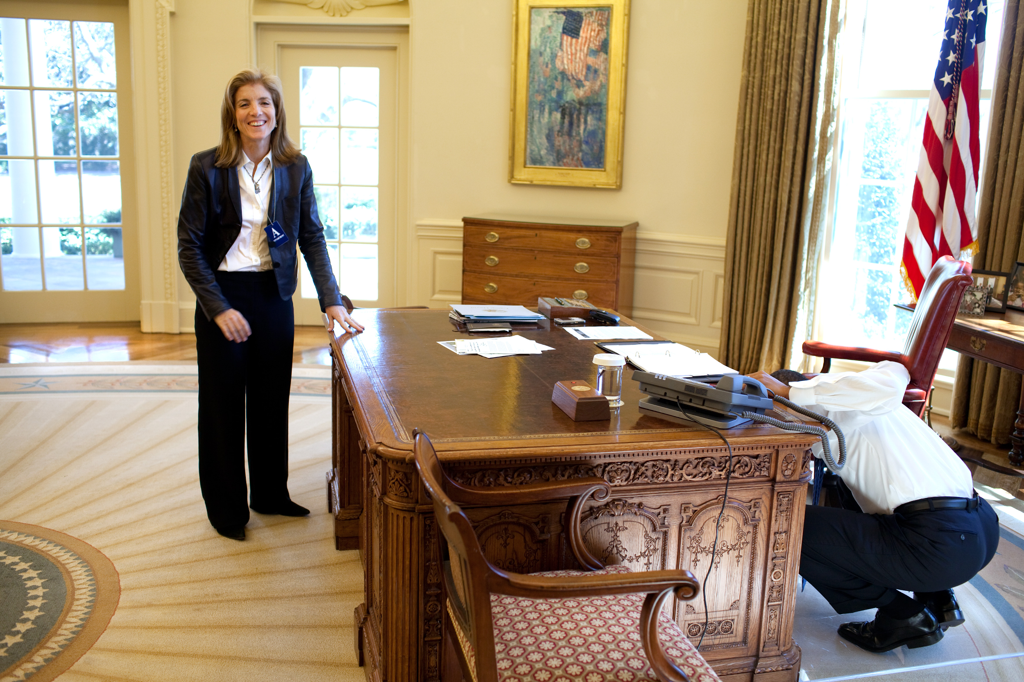
Surprises?
Democrat or Republican
Amendments
World Wars

Slide 10
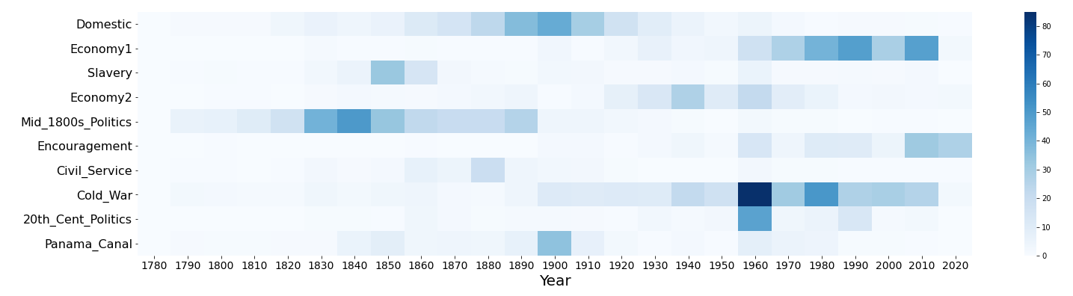
Speech Topics Over the Years

Slide 11
Speech Topics Over the Years

Slide 12
Speech Topics Over the Years
1800s Politics
mexico, treasury, treaty, amount, territory, duties, revenue, condition, bank

Slide 13
Speech Topics Over the Years

Slide 14
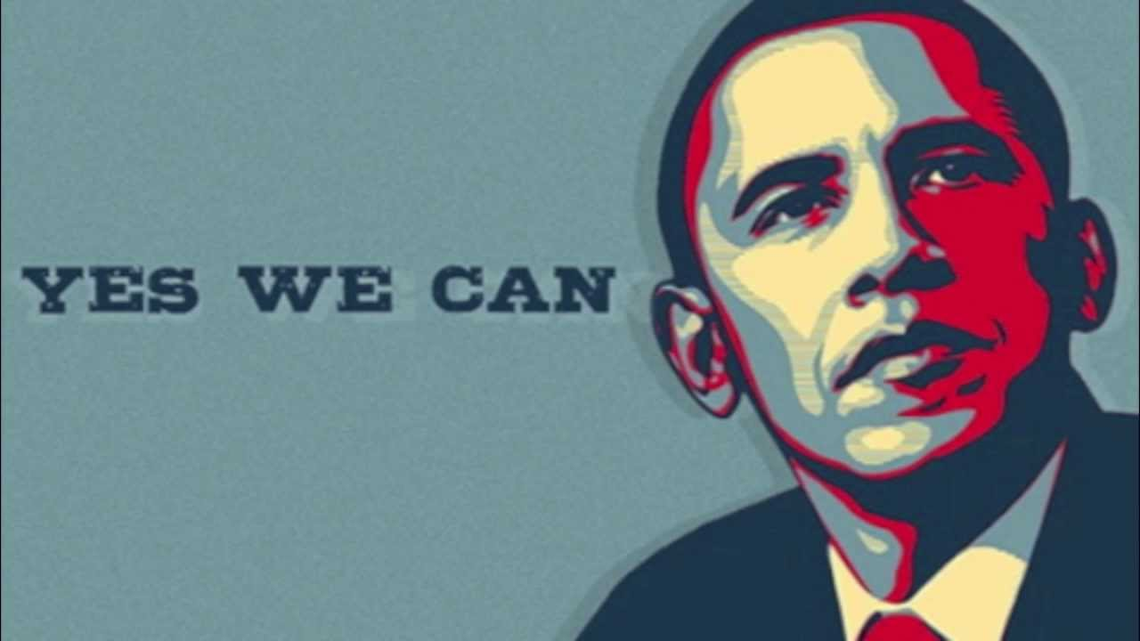
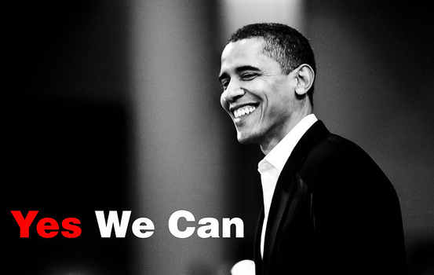
Speech Topics Over the Years

Slide 15
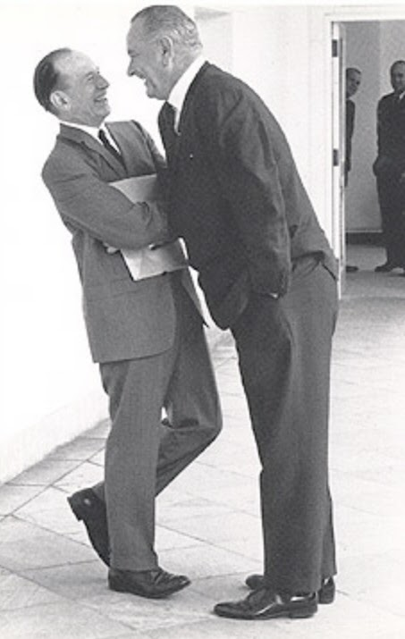
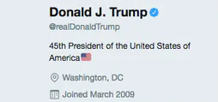
Sentiment

Slide 16

Sentiment

Slide 17
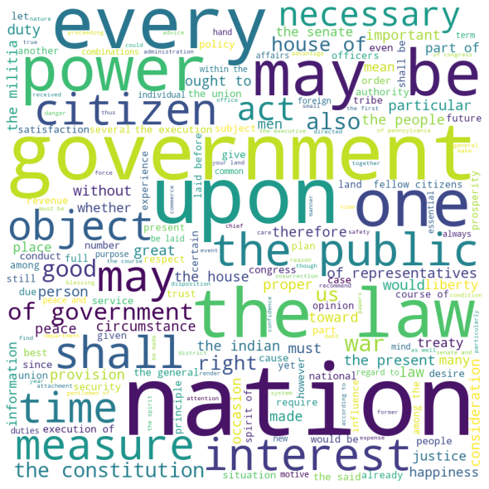
Farewell
My feelings do not permit me to suspend the deep acknowledgment ... for the opportunities I have thence enjoyed of manifesting my inviolable attachment, by services faithful and persevering, though in usefulness unequal to my zeal.
-George Washington

